Slide 1

Analytics, Data Science and A I: Systems for Decision Support
Eleventh Edition
Chapter 4
Data Mining Process, Methods, and Algorithms
Slide in this Presentation Contain Hyperlinks. JAWS users should be able to get a list of links by using INSERT+F7
Copyright © 2020, 2015, 2011 Pearson Education, Inc. All Rights Reserved
Notes:
If this PowerPoint presentation contains mathematical equations, you may need to check that your computer has the following installed:
1) Math Type Plugin
2) Math Player (free versions available)
3) NVDA Reader (free versions available)

Slide 2
Learning Objectives
4.1 Define data mining as an enabling technology for business analytics
4.2 Understand the objectives and benefits of data mining
4.3 Become familiar with the wide range of applications of data mining
4.4 Learn the standardized data mining processes
4.5 Learn different methods and algorithms of data mining.
4.6 Build awareness of the existing data mining software tools
4.7 Understand the privacy issues, pitfalls, and myths of data mining
Notes:
Slide 2 is list of textbook LO numbers and statements

Slide 3
What is Data Mining?
Data mining is a process that uses statistics, mathematical, and AI technologies to extract and identify useful information and subsequent knowledge (or patterns) from large sets of data.

Slide 4
Definition of Data Mining
The nontrivial process of identifying valid, novel, potentially useful, and ultimately understandable patterns in data stored in structured databases. -- Fayyad et al., (1996)
Keywords in this definition: Process, nontrivial, valid, novel, potentially useful, understandable.
Other names: knowledge extraction, pattern analysis, knowledge discovery, information harvesting, pattern searching, data dredging.

Slide 5
Opening Vignette
Miami-Dade Police Department Is Using Predictive Analytics to Foresee and Fight Crime
Predictive analytics in law enforcement
Policing with less
New thinking on cold cases
The big picture starts small
Success brings credibility
Just for the facts
Safer streets for smarter cities

Slide 6
Data Mining Concepts and Definitions: Why Data Mining?
More intense competition at the global scale.
Recognition of the value in data sources.
Availability of quality data on customers, vendors, transactions, Web, etc.
Consolidation and integration of data repositories into data warehouses.
The exponential increase in data processing and storage capabilities.
Decrease in hardware and software for data storage & processing costs.
Movement toward conversion of information resources into nonphysical form.

Slide 7
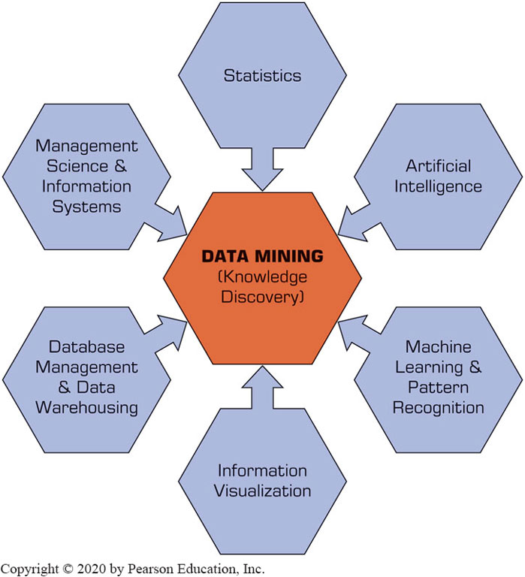
Data Mining Is a Blend of Multiple Disciplines
Figure 4.1 Data Mining Is a Blend of Multiple Disciplines.

Slide 8
Data Mining Characteristics & Objectives
Source of data for D M is often a consolidated data warehouse (not always!).
D M environment is usually a client-server or a Web-based information systems architecture.
Data is the most critical ingredient for D M which may include soft/unstructured data.
The miner is often an end user
Striking it rich requires creative thinking
Data mining tools’ capabilities and ease of use are essential (Web, parallel processing, etc.)

Slide 9
How Data Mining Works
D M extract patterns from data
Pattern? A mathematical (numeric and/or symbolic) relationship among data items
Types of patterns
There are four different types of patterns:
Prediction: tell the nature of future occurrences of certain events based on what has happened in the past, such as predicting the winner of the Super Bowl or forecasting the absolute temperature of a particular day.
Association: find the commonly co-occurring groupings of things, such as baby formula and diapers going together in market-basket analysis.

Slide 10
How Data Mining Works
Types of patterns (continued)
Clusters (or segmentation): identify natural groupings of things based on their known characteristics, such as assigning customers in different segments based on their demographics and past purchase behaviors.
Sequential relationships: discover time-ordered events, such as predicting that an existing banking customer who already has a checking account will open a savings account followed by an investment account within a year.

Slide 11
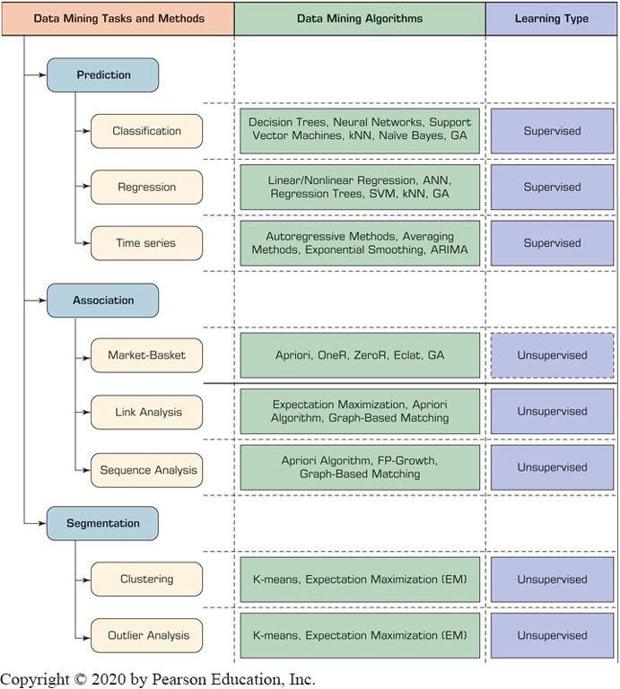
A Taxonomy for Data Mining
Figure 4.2 A Simple Taxonomy for Data Mining Tasks, Methods, and Algorithms.

Slide 12
Other Data Mining Patterns/Tasks
Time-series forecasting
Part of the sequence or link analysis?
Visualization
Another data mining task?
Data Mining versus Statistics
Are they the same?
What is the relationship between the two?

Slide 13
Data Mining Applications (1 of 4)
Customer Relationship Management
Maximize return on marketing campaigns
Improve customer retention (churn analysis)
Maximize customer value (cross-, up-selling)
Identify and treat most valued customers
Banking & Other Financial
Automate the loan application process
Detecting fraudulent transactions
Maximize customer value (cross-, up-selling)
Optimizing cash reserves with forecasting

Slide 14
Data Mining Applications (2 of 4)
Retailing and Logistics
Optimize inventory levels at different locations
Improve the store layout and sales promotions
Optimize logistics by predicting seasonal effects
Minimize losses due to limited shelf life
Manufacturing and Maintenance
Predict/prevent machinery failures
Identify anomalies in production systems to optimize the use manufacturing capacity
Discover novel patterns to improve product quality

Slide 15
Data Mining Applications (3 of 4)
Brokerage and Securities Trading
Predict changes on certain bond prices
Forecast the direction of stock fluctuations
Assess the effect of events on market movements
Identify and prevent fraudulent activities in trading
Insurance
Forecast claim costs for better business planning
Determine optimal rate plans
Optimize marketing to specific customers
Identify and prevent fraudulent claim activities

Slide 16
Data Mining Applications (4 of 4)
Computer hardware and software
Science and engineering
Government and defense
Homeland security and law enforcement
Travel, entertainment, sports
Healthcare and medicine
Sports,… virtually everywhere…

Slide 17
Data Mining Process
A manifestation of the best practices
A systematic way to conduct D M projects
Moving from Art to Science for D M project
Everybody has a different version
Most common standard processes:
C R I S P-D M (Cross-Industry Standard Process for Data Mining)
S E M M A (Sample, Explore, Modify, Model, and Assess)
K D D (Knowledge Discovery in Databases)

Slide 18
Data Mining Process: C R I S P-D M (1 of 2)
Cross Industry Standard Process for Data Mining
Proposed in 1990s by a European consortium
Composed of six consecutive phases
Step 1: Business Understanding
Step 2: Data Understanding
Step 3: Data Preparation
Step 4: Model Building
Step 5: Testing and Evaluation
Step 6: Deployment

Slide 19
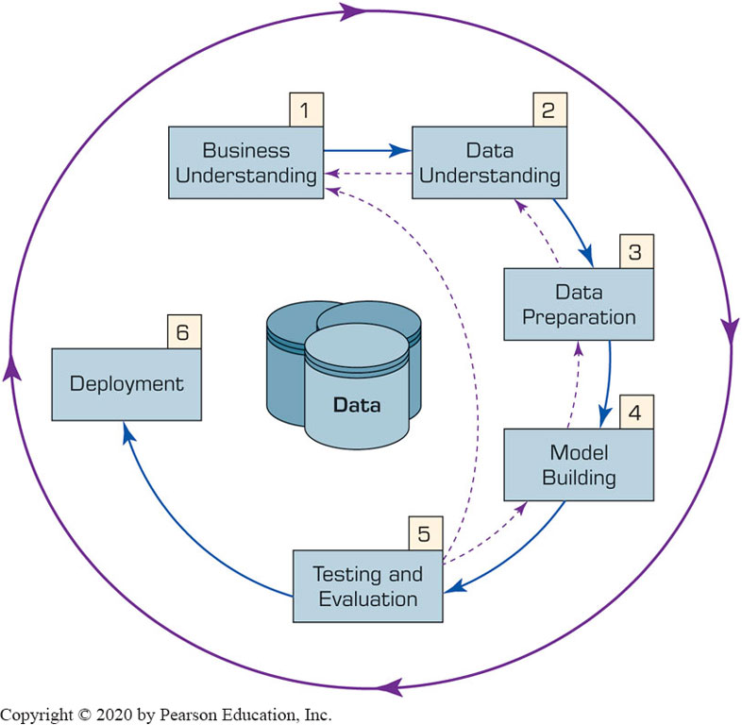
Data Mining Process: C R I S P-D M (2 of 2)
Figure 4.3 The Six-Step C R I S P-D M Data Mining Process. →
The process is highly repetitive and experimental (D M: art versus science?)

Slide 20
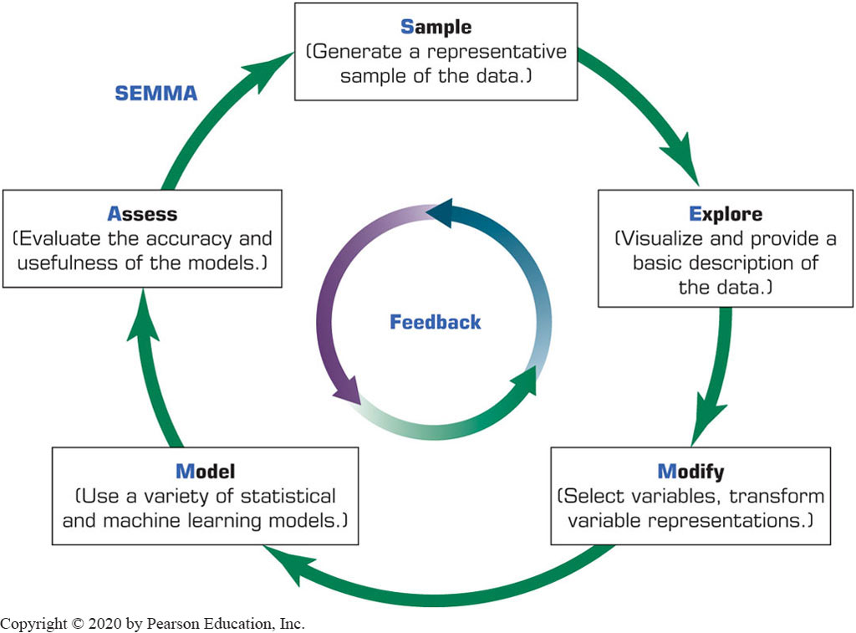
Data Mining Process: S E M M A
Figure 4.5 S E M M A Data Mining Process.
Developed by S A S Institute

Slide 21
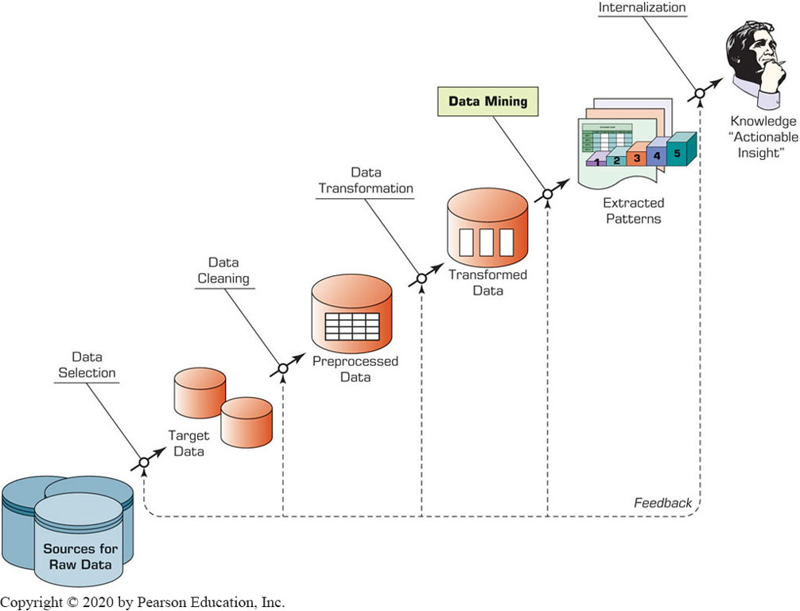
Data Mining Process: K D D
Figure 4.6 K D D (Knowledge Discovery in Databases) Process.

Slide 22
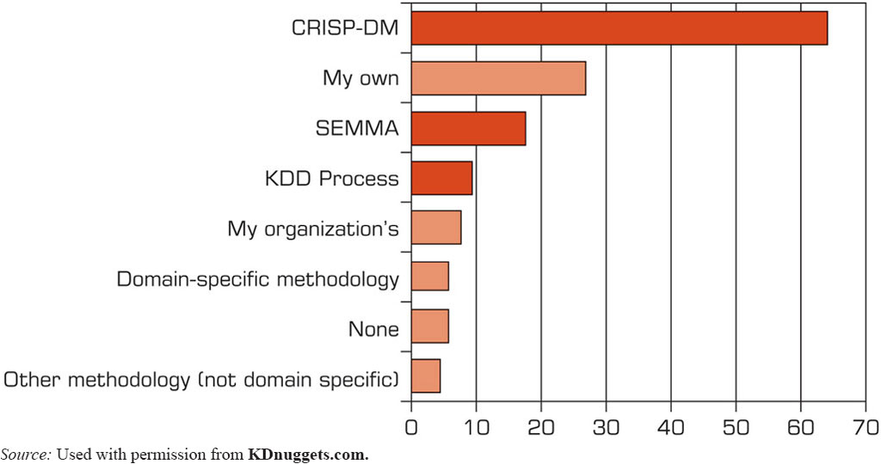
What Data Mining Methodology are you using?
Figure 4.7 Ranking of Data Mining Methodologies/Processes.
Source: Used with permission from KDnuggets.com.

Slide 23
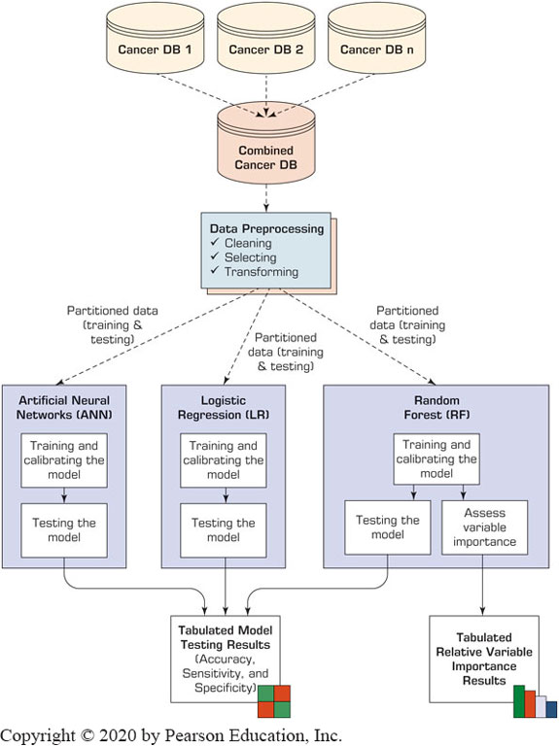
Application Case 4.4
Data Mining Helps in Cancer Research
Questions for Discussion
How can data mining be used for ultimately curing illnesses like cancer?
What do you think are the promises and major challenges for data miners in contributing to medical and biological research endeavors?

Slide 24
Best Algorithms based on type of DM Task
Depending on the business need, different types of data mining tasks can be used: prediction, clustering, or association.
Most popular algorithms to be used based on type of task:
decision trees for classification (prediction),
k-means for clustering (segmentation),
Apriori algorithm for association rule mining.

Slide 25
Data Mining Methods for Prediction:
Classification versus regression
Classification – what is being predicted is a class label
weather: sunny, cloudy, rainy
credit approval: good, bad credit risk
Regression: what is being predicted is a numeric value
Temperature: 31
Number of attendees: 100,000

Slide 26
Data Mining Methods: Classification
Most frequently used D M method
Part of the machine-learning family
Employ supervised learning
Learn from past data, classify new data

Slide 27
Data Mining Methods: Classification
The output variable is categorical (nominal or ordinal) in nature
Nominal data:
data that can be labelled or classified into mutually exclusive categories within a variable.
Categories cannot be ordered in a meaningful way.
Example, for the nominal variable of preferred mode of transportation, you may have the categories of car, bus, train, tram or bicycle.
Ordinal data:
statistical data type where the variables have natural, ordered categories
Example: For a grading system: excellent, very good, good, poor;
or for winner in a race: first, second, third.

Slide 28
Data Mining Methods: Classification
Two-step Methodology of classification-type prediction involves:
Model development/training
A collection of input data (variables), including the predicted actual known class labels (for loans approval as an example: good, risky) is used for building and train the model.
Model testing/deployment
The model is tested against the holdout sample for accuracy assessment and eventually deployed for actual use where it is to predict classes of new data instances (where the class label is unknown).

Slide 29
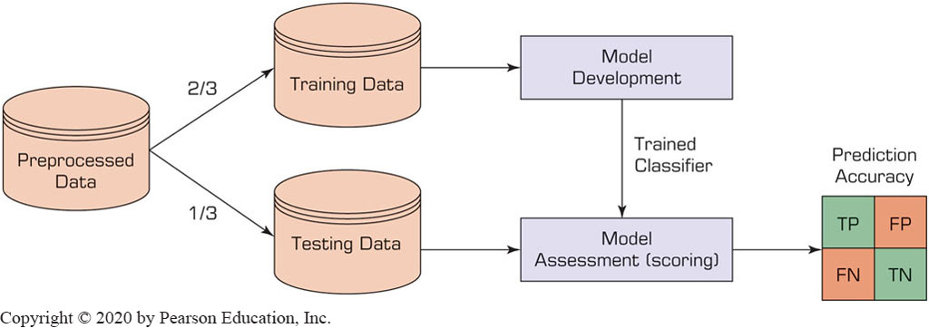
Estimation Methodologies for Classification: Single/Simple Split
Simple split (or holdout or test sample estimation)
Split the data into 2 mutually exclusive sets: training (~70%) and testing (30%)

Slide 30
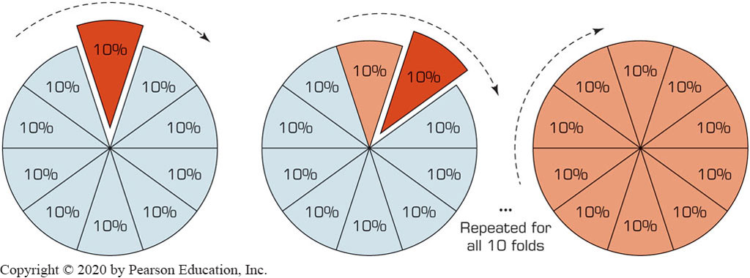
Estimation Methodologies for Classification: k-Fold Cross Validation
Data is split into k mutual subsets and k number training/testing experiments are conducted
Figure 4.10 A Graphical Depiction of k-Fold Cross-Validation.

Slide 31
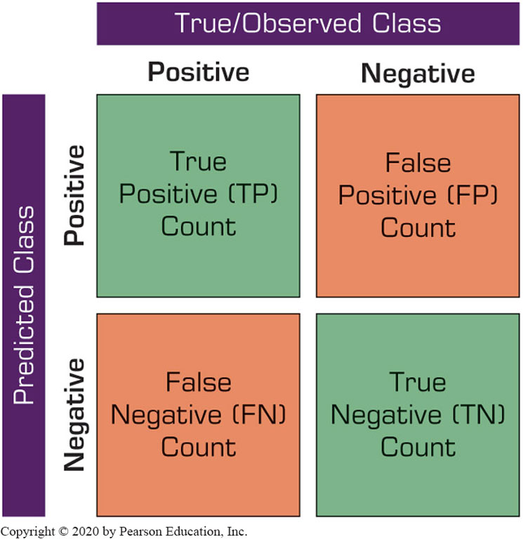
Accuracy of Classification Models
In classification problems, the primary source for accuracy estimation is the confusion matrix (or, classification matrix)
Figure 4.8 Matrix for tabulation of two-classification results

Slide 32
Classification Techniques
Decision tree analysis
Statistical analysis
Neural networks
Support vector machines
Case-based reasoning
Bayesian classifiers
Genetic algorithms
Rough sets

Slide 33
Decision Trees
Employs a divide-and-conquer method
Recursively divides a training set until each division consists of examples from one class:
A general algorithm (steps) for building a decision tree
Create a root node and assign all of the training data to it.
Select the best splitting attribute.
Add a branch to the root node for each value of the split. Split the data into mutually exclusive subsets along the lines of the specific split.
Repeat the steps 2 and 3 for each and every leaf node until the stopping criteria is reached.

Slide 34
Decision Trees
D T algorithms mainly differ on
Splitting criteria
Which variable, what value, etc.
Stopping criteria
When to stop building the tree
Pruning (generalization method)
Which parts of the tree to remove
Most popular D T algorithms include
I D3, C4.5, C5; C A R T; C H A I D; M5

Slide 35
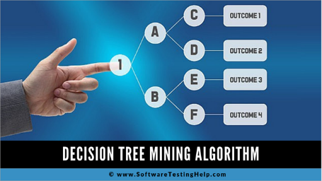
Decision Trees
Source:
https://www.softwaretestinghelp.com/decision-tree-algorithm-examples-data-mining/

Slide 36
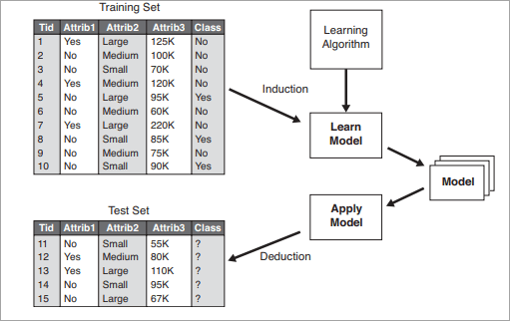
Decision Trees
Source of image:
https://www.softwaretestinghelp.com/decision-tree-algorithm-examples-data-mining/

Slide 37
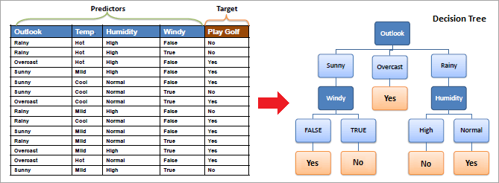
Decision Trees
Example: Should I play golf or not?
Source of image:
https://www.softwaretestinghelp.com/decision-tree-algorithm-examples-data-mining/

Slide 38
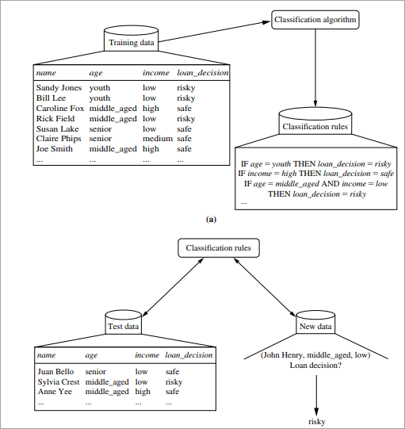
Decision Trees
Example: Should I give a loan or not?
Source of image:
https://www.softwaretestinghelp.com/decision-tree-algorithm-examples-data-mining/

Slide 39
Cluster Analysis for Data Mining (1 of 4)
Used for automatic identification of natural groupings of things
Part of the machine-learning family
Employ unsupervised learning
Learns the clusters of things from past data, then assigns new instances
There is not an output/target variable
In marketing, it is also known as segmentation

Slide 40
Cluster Analysis for Data Mining (2 of 4)
Clustering results may be used to
Identify natural groupings of customers
Identify rules for assigning new cases to classes for targeting/diagnostic purposes
Provide characterization, definition, labeling of populations
Decrease the size and complexity of problems for other data mining methods
Identify outliers in a specific domain (e.g., rare-event detection)

Slide 41
Cluster Analysis for Data Mining (3 of 4)
Analysis methods
Statistical methods such as k-means, k-modes, and so on.
Neural networks (adaptive resonance theory [A R T], self-organizing map [S O M])
Fuzzy logic (e.g., fuzzy c-means algorithm)
Genetic algorithms
How many clusters?

Slide 42
Cluster Analysis for Data Mining (4 of 4)
k-Means Clustering Algorithm
k: pre-determined number of clusters
Algorithm (Step 0: determine value of k)
Step 1: Randomly generate k random points as initial cluster centers.
Step 2: Assign each point to the nearest cluster center.
Step 3: Re-compute the new cluster centers.
Repetition step: Repeat steps 2 and 3 until some convergence criterion is met (usually that the assignment of points to clusters becomes stable).

Slide 43
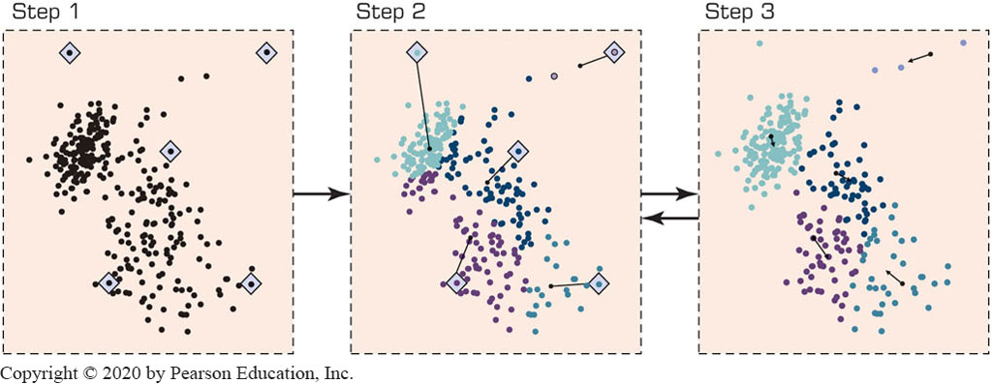
Cluster Analysis for Data Mining - k-Means Clustering Algorithm
Figure 4.13 A Graphical Illustration of the Steps in the k-Means Algorithm.

Slide 44
Association Rule Mining (1 of 7)
A very popular D M method in business
Finds interesting relationships (affinities) between variables (items or events)
Part of machine learning family
Employs unsupervised learning
There is no output variable
Also known as market basket analysis or affinity analysis

Slide 45
Association Rule Mining (2 of 7)
Input: the simple point-of-sale transaction data
Output: Most frequent affinities among items
Example: according to the transaction data…
“Customer who bought a lap-top computer and a virus protection software, also bought extended service plan 70 percent of the time."
How do you use such a pattern/knowledge?
Put the items next to each other
Promote the items as a package
Place items far apart from each other!

Slide 46
Association Rule Mining (3 of 7)
A representative applications of association rule mining include
In business: cross-marketing, cross-selling, store design, catalog design, e-commerce site design, optimization of online advertising, product pricing, and sales/promotion configuration
In medicine: relationships between symptoms and illnesses; diagnosis and patient characteristics and treatments (to be used in medical D S S); and genes and their functions (to be used in genomics projects)
…

Slide 47
Association Rule Mining (4 of 7)
Are all association rules interesting and useful?
A Generic Rule: X ⇒ Y [S%, C%]
X, Y: products and/or services
X: Left-hand-side (L H S) ~ antecedent
Y: Right-hand-side (R H S) ~ consequent
S: Support: how often X and Y go together
Supp(X➔Y) = (Number of baskets that contain both X & Y)
Total number of baskets
C: Confidence: how often Y go together with the X
Confidence(X➔Y) = Supp(X➔Y) / Supp(X)

Slide 48
Association Rule Mining (5 of 7)
Example:
In the total number of transactions data:
{Laptop Computer, Antivirus Software} ⇒ {Extended Service Plan} [30%, 75%]
laptops, antivirus software, and extended service plan were present in 30% of total transactions, and
in cases where laptops and antivirus software were present also extended service plan was found 75% of the time.
If total transactions = 100,
Number of times laptops, antivirus, and extended service plan were found together 30 times
If number of laptops and antivirus (together) were found in 40 transactions, for these 40 times, it was found that extended service plan was ALSO present 30 times: 30/40 = 75%

Slide 49
Association Rule Mining (6 of 7)
Several algorithms are developed for discovering (identifying) association rules
Apriori
Eclat
F P-Growth
+ Derivatives and hybrids of the three
The algorithms help identify the frequent item sets, which are, then converted to association rules

Slide 50
Association Rule Mining (7 of 7)
Apriori Algorithm
Finds subsets that are common to at least a minimum number of the itemsets (support value)
Uses a bottom-up approach
frequent subsets are extended one item at a time (the size of frequent subsets increases from one-item subsets to two-item subsets, then three-item subsets, and so on), and
groups of candidates at each level are tested against the data for minimum support value. (see the figure next slide)

Slide 51
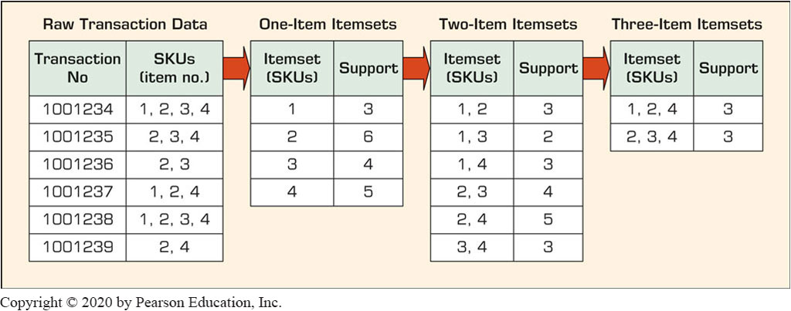
Association Rule Mining Apriori Algorithm
Figure 4.14 A Graphical Illustration of the Steps in the Apriori Algorithm.
Set minimum support value in this example to be 3

Slide 52
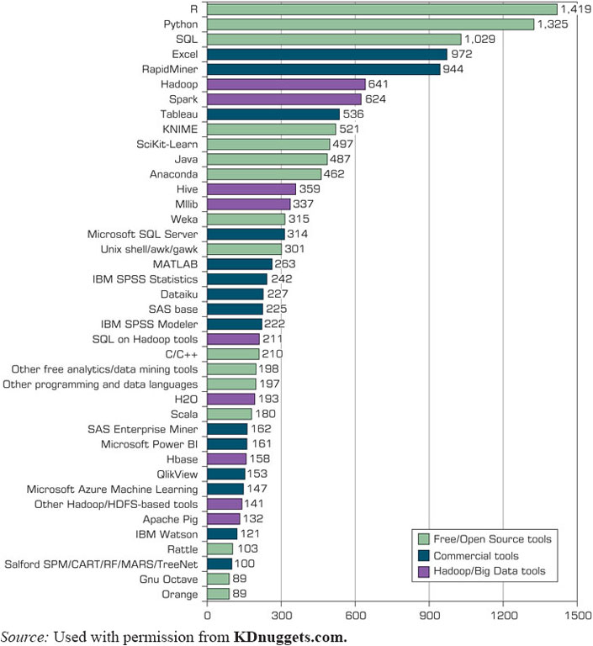
Data Mining Software Tools
Figure 4.15 Popular Data Mining Software Tools (Poll Results).
Commercial
I B M S P S S Modeler (formerly Clementine)
S A S Enterprise Miner
Statistica - Dell/Statsoft
… many more
Free and/or Open Source
K N I M E
RapidMiner
Weka
R, …
Source: Used with permission from KDnuggets.com.

Slide 53
Application Case 4.6 (1 of 4)
Data Mining Goes to Hollywood: Predicting Financial Success of Movies
Goal: Predicting financial success of Hollywood movies before the start of their production process
How: Use of advanced predictive analytics methods.
Results: promising.

Slide 54
Application Case 4.6 (2 of 4)
Data Mining Goes to Hollywood: Predicting Financial Success of Movies
A Typical Classification Problem
Table 4.3 Movie Classification based on Receipts
Class No. | 1 | 2 | 3 | 4 | 5 | 6 | 7 | 8 | 9
Range (in millions of dollars) | >1 (Flop) | >1 <610 | >10 <20 | >20 <640 | >40 <665 | >65 <6100 | >100 <6150 | >150 <6200 | >200 (Blockbuster)
Table 4.4 Summary of Independent Variables
Independent Variable | Number of Values | Possible Values
M P A A Rating | 5 | G, P G, P G-13, R, N R
Competition | 3 | High, medium, low
Star value | 3 | High, medium, low
Genre | 10 | Sci-Fi, Historic Epic Drama, Modern Drama, Politically Related, Thriller, Horror, Comedy, Cartoon, Action, Documentary
Special effects | 3 | High, medium, low
Sequel | 2 | Yes, no
Number of screens | 1 | A positive integer between 1 and 3,876

Slide 55
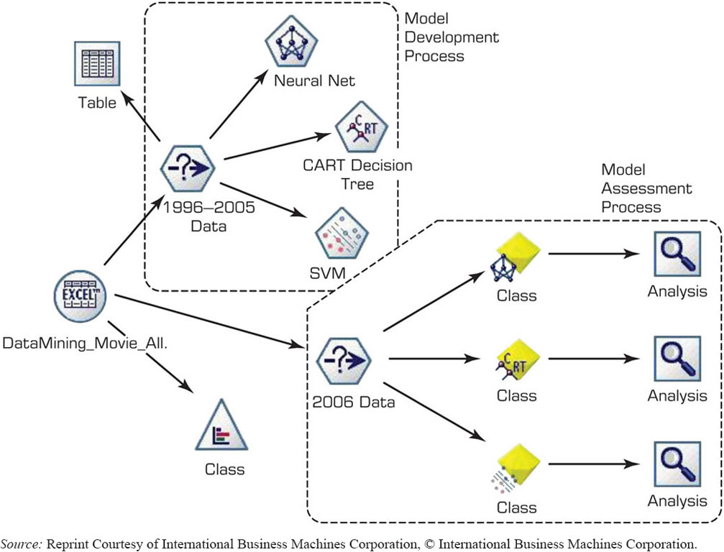
Application Case 4.6 (3 of 4)
Data Mining Goes to Hollywood: Predicting Financial Success of Movies
FIGURE 4.16 Process Flow Screenshot for the Box-Office Prediction System.
The D M Process Map in I B M S P S S Modeler
Source: Reprint Courtesy of International Business Machines Corporation, © International Business Machines Corporation.

Slide 56
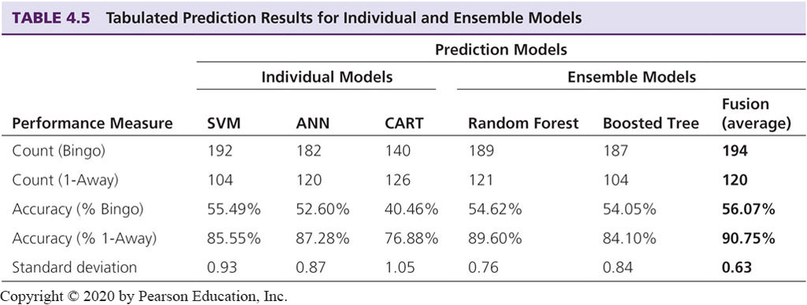
Application Case 4.6 (4 of 4)
Data Mining Goes to Hollywood: Predicting Financial Success of Movies

Slide 57

Copyright
This work is protected by United States copyright laws and is provided solely for the use of instructors in teaching their courses and assessing student learning. Dissemination or sale of any part of this work (including on the World Wide Web) will destroy the integrity of the work and is not permitted. The work and materials from it should never be made available to students except by instructors using the accompanying text in their classes. All recipients of this work are expected to abide by these restrictions and to honor the intended pedagogical purposes and the needs of other instructors who rely on these materials.

